Slide 1
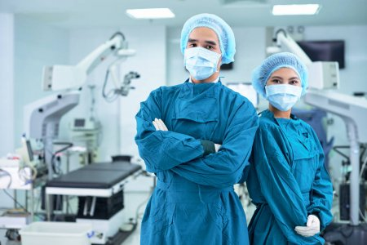
When I was at school, I wanted to become a surgeon.
But my math and programming skills have changed my mind.

Slide 2

So, I'm going to talk about my future job.

Slide 3

Programming is a creative work.

Slide 4
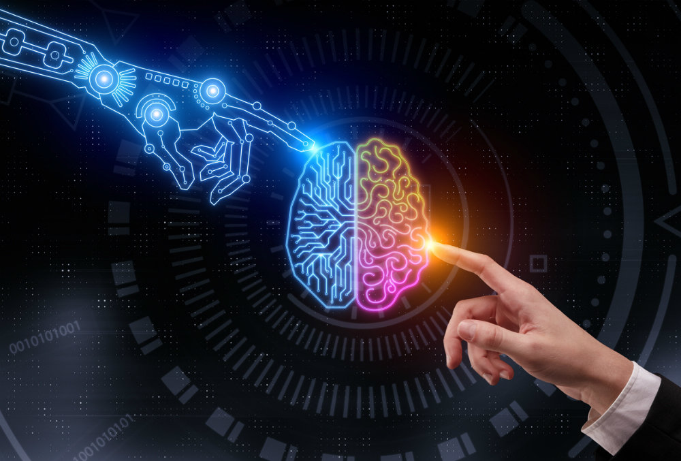
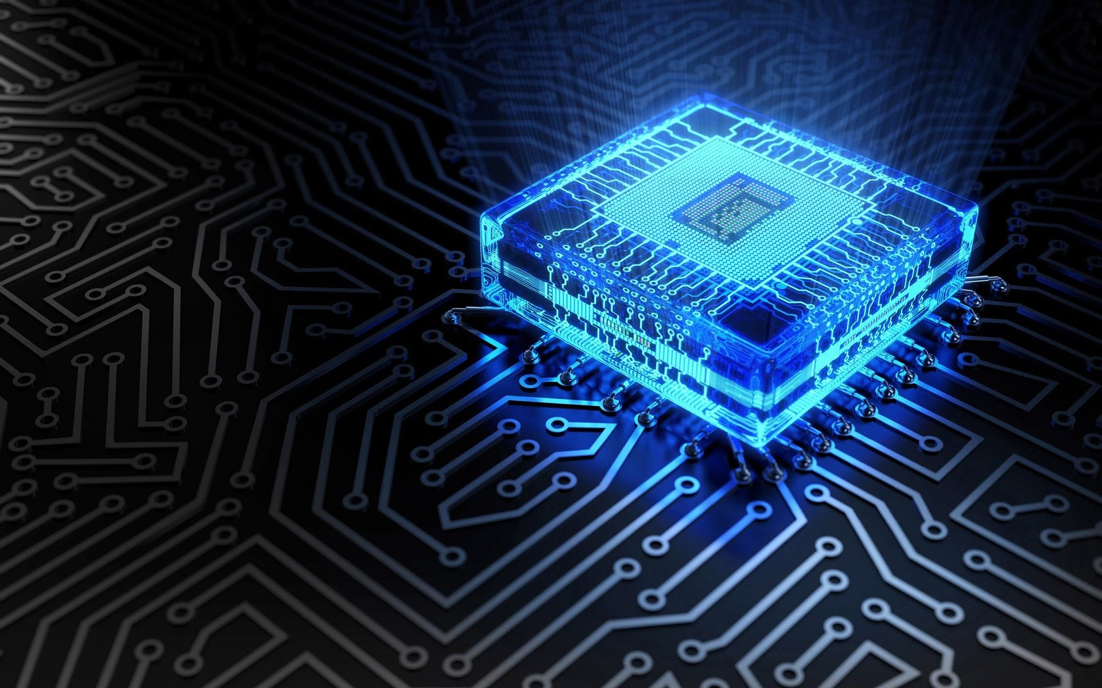
In the future, I want to work with the creation of:
artificial intelligence (AI)
embedded programming

Slide 5
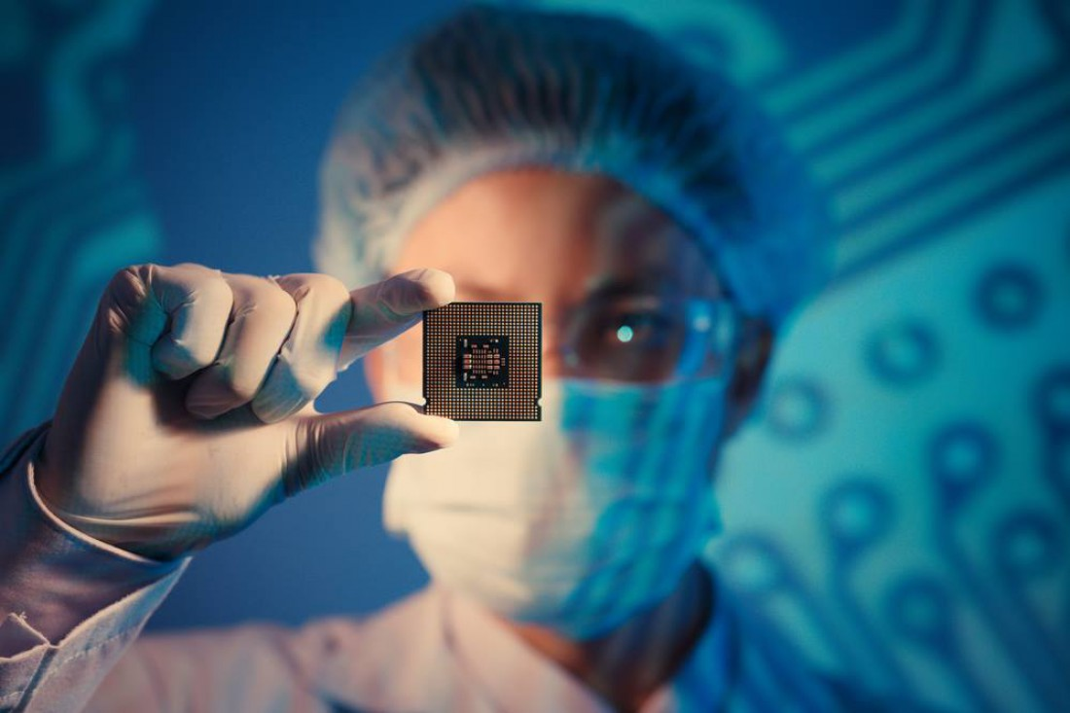
EMBEDDED
Embedded programming is the
encoding of different
chips and boards.

Slide 6
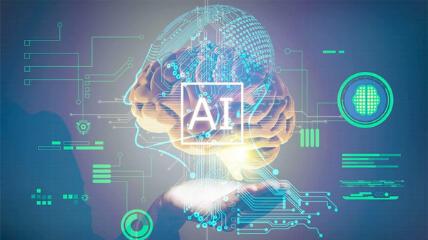
AI
Artificial Intelligence (AI) is
already being developed,
but it is not perfect..

Slide 7
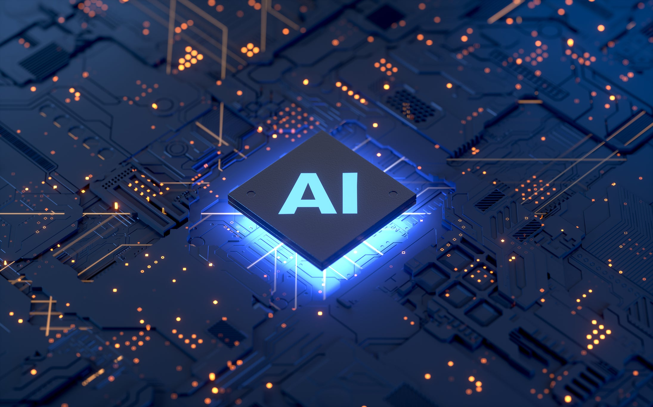
AI & EMBEDDED
Artificial intelligence
programming and
embedded programming
are very interconnected.

Slide 8
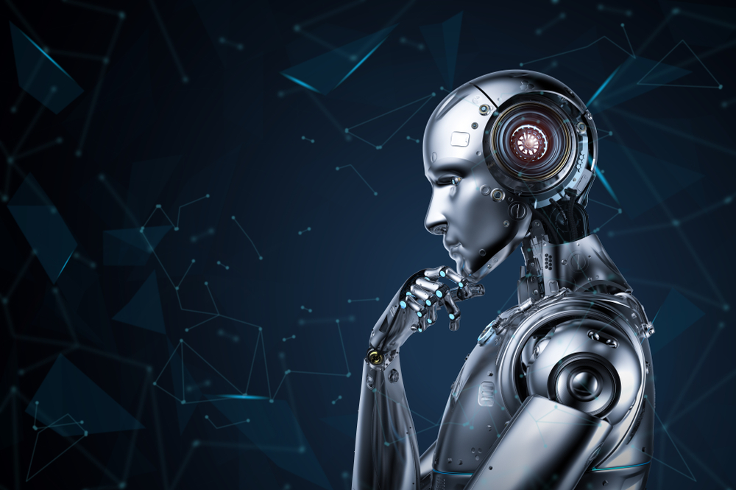
The full creation of
Artificial Intelligence
is a very great step
in the future.

Slide 9
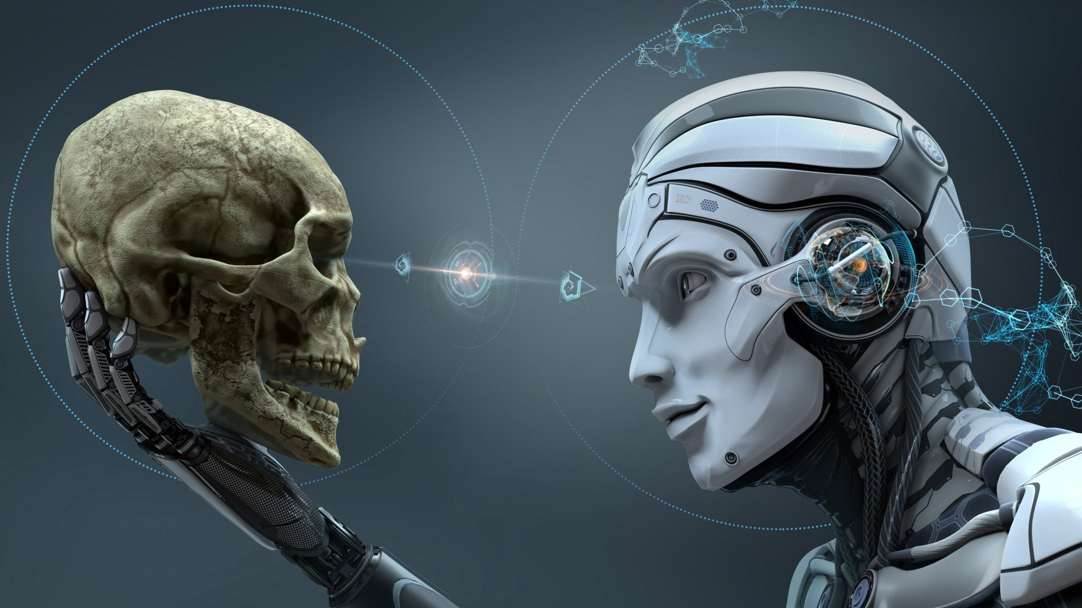
I hope that in the future, I and my team will be able to do it.

